Slide 1
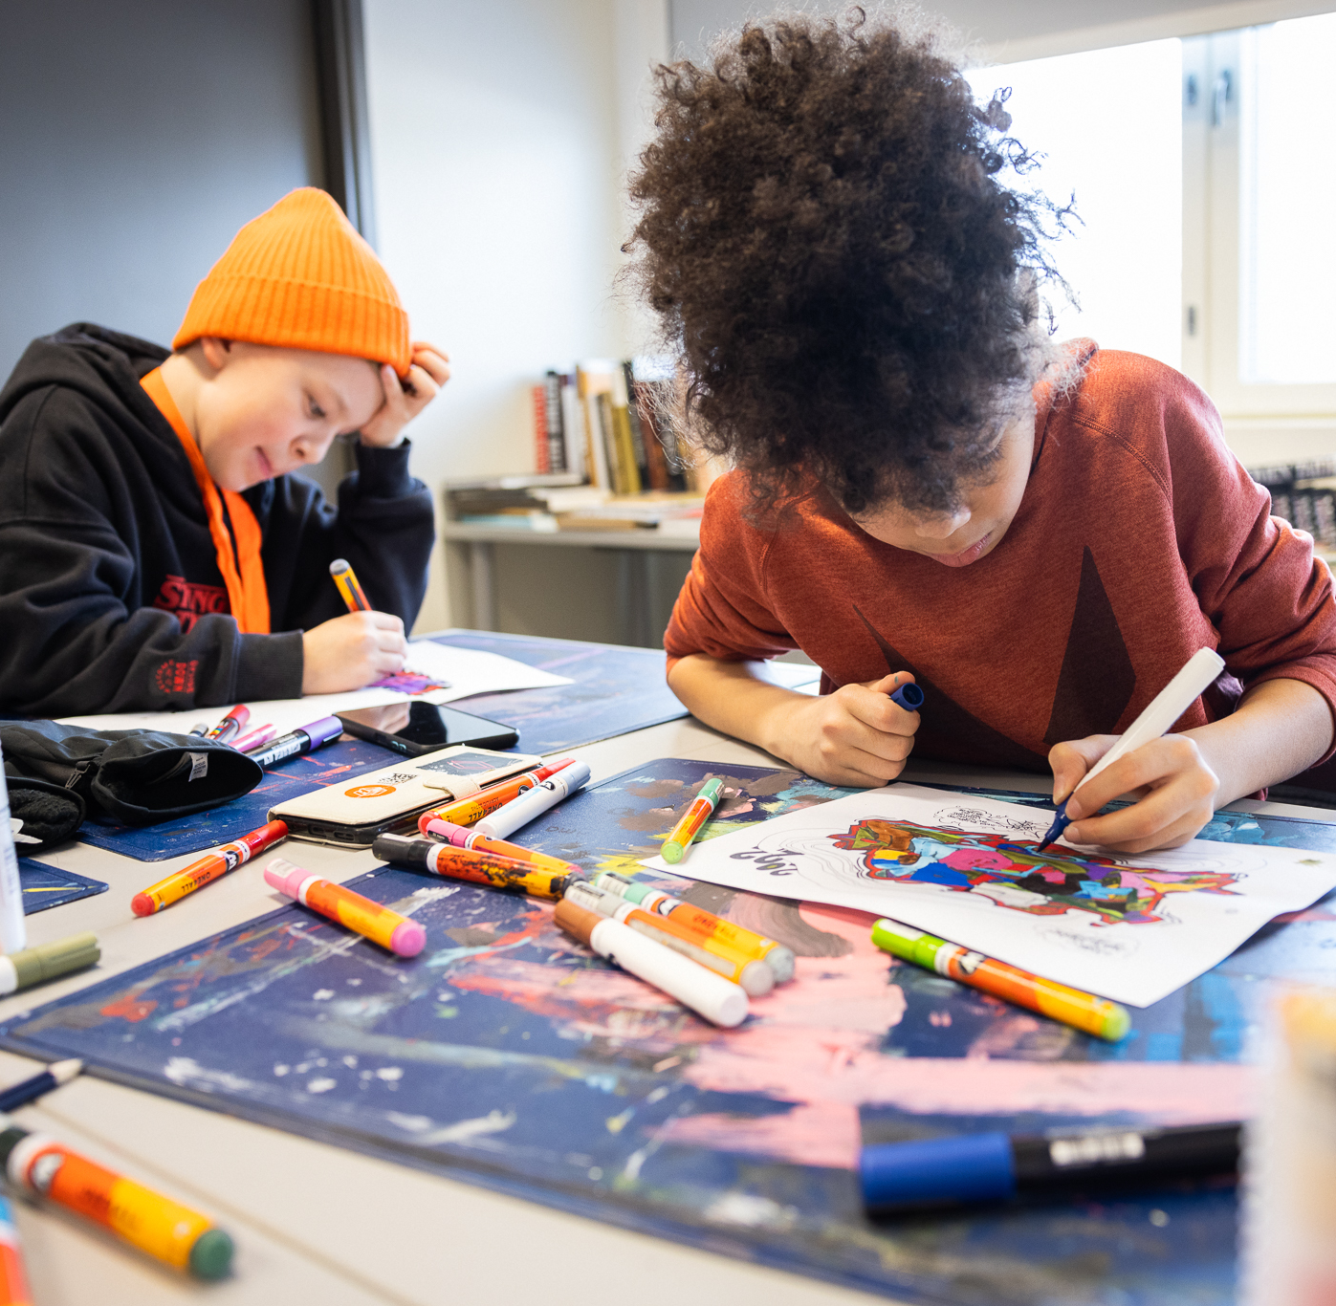
Procurement and scheduling platform for Espoo Hobby Path
Kimmo Sillanmikko, project manager

Slide 2
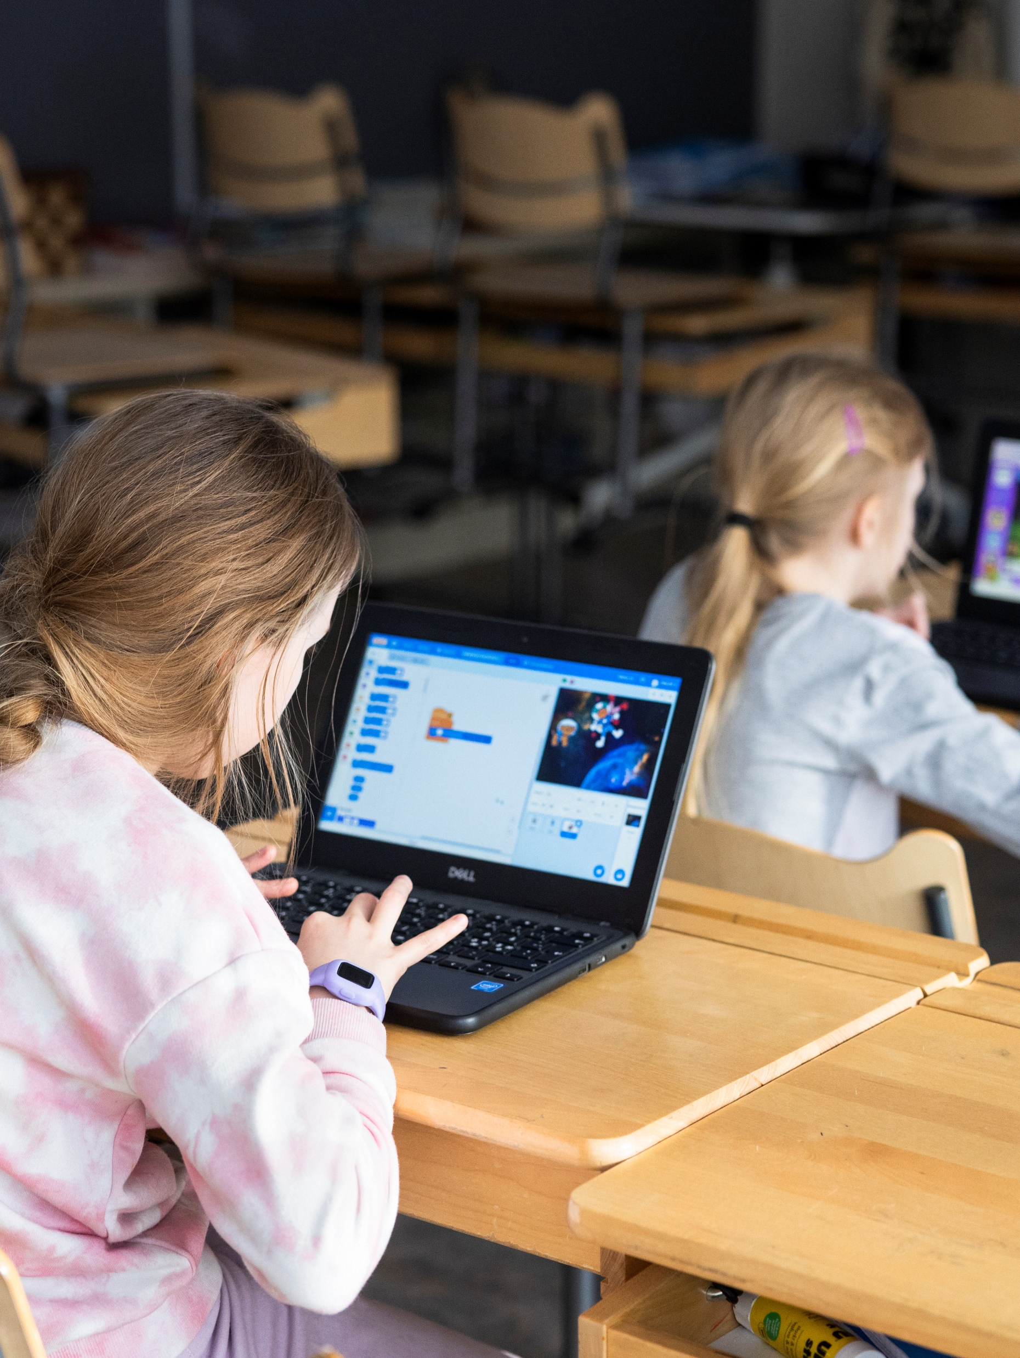
Project
200+ hobby groups in 84 schools from 30 different providers
-> a lot of copy-paste = work and room for mistakes
Build a tool for schools and service providers to better communicate and plan leisure activities
Define the different needs of all stakeholders and provide a viable solution ​within the allocated time
Learning experience also for us

